Slide 1
Introduction to Linux/Unix Operating System

Slide 2
Operating System
Is is a software that enables the communications between the computer hardware and software.
Operating system manage and operate the computing device like- computer, smartphones.

Slide 3
Examples of operating Systems
Windows
Ubuntu
macOS
Unix
Android

Slide 4
Linux || Unix
Both are different Operating System.
Most of the unix and linux commands are similar in nature.
Unix is older than linux and windows.
Linux is open source and unix is used by only the copyrighters. (ex- IBM,HP etc ).
Linux is a unix clone.

Slide 5
Linux
Linux is an open-source fastest growing operating system like other operating systems such as Microsoft , iOS, android, etc.
It was developed by Linus Torvalds in 1991.
Now a days linux is also used in embedded systems like routers, automation controls, television, smartwatches etc.

Slide 6
Features of Linux
Secure
Open source
free
Good performance
Community support

Slide 7
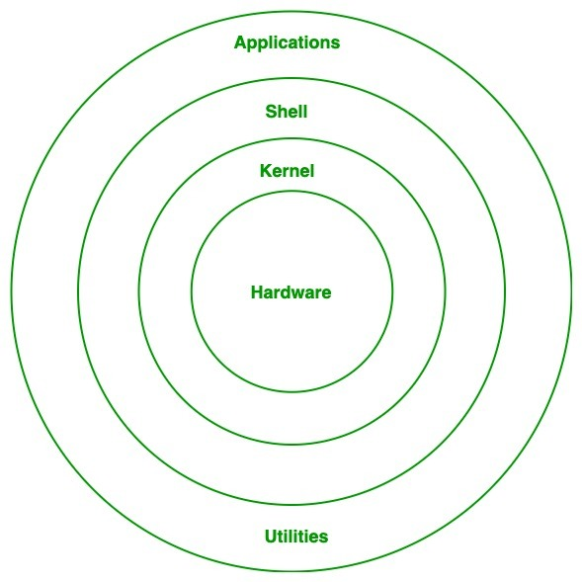
Architecture of Linux

Slide 8
Architecture of Linux
Kernel : Kernel is the most important part of the OS.
It is the core of the linux based OS.
It is interface between the hardware and processes of a computer. it serves as the bridge between the OS and H/W.
Types of kernel :-
Monolithic kernel
Hybrid kernel
Exo kernel
Micro kernel
Nano kernel

Slide 9
Types of kernel
MONOLITHIC KERNEL--: In monolithic kernel same memory space is used to implement user services and kernel services.
example - Unix, Linux etc.
Advantage :-
execution of processes is also faster than other kernel type because using same memory space.
Disadvantage:-
large in size and if any service generate any error it may crash the whole system.

Slide 10
Types of kernel
MICRO KERNEL --: In this user services and kernel services are implemented into two different address : user space and kernel space.
example: AmigaOS,K42
Advantage :-
because of using different spaces for both services, size of microkernel is decreased.
easy to manage compare to monolithic kernel.
Disadvantage :-
process management is very complecated.

Slide 11
Hybrid, Nano & Exo Kernel
HYBRID KERNEL --: known as modular kernel.
It is the combination of both monolithic and micro kernel.
Example :- Netware , windows NT
NANO KERNEL :- this kernel is very small in size and it offers hardware abstraction without system services.
EXO KERNEL: This offers process protection and resource handling and nothing else.

Slide 12
Various Function of Kernel
process management
access computer resources
device management
memory management
i/o communication
task management

Slide 13
Shell
It is Linux command line interpreter.
It provide an interface between user and the kernel.
It take the commands through the user and runs the functions of the kernel.
Types of shell :-
i)Bourne shell (sh)
ii)Korn Shell(ksh)
iii) Bourne Again shell(BASH)
iv) POSIX shell (sh)
V) C shell

Slide 14
Hardware Layer & System Utility
Hardware Layer
This layer consists all peripheral devices like RAM/HDD/CPU etc.
System Utility
It provides the functionalities of an operating system to the user.

Slide 15
Introduction to Embedded Linux and it Flavors.

Slide 16
Embedded System
Embedded system :-
Embedded system is the special system computer custom built to serve a specific purpose.
For example : a calculator is the special purpose computer as compared to laptop.
Embedded system is flexible , low cost as compare to general purpose computer.

Slide 17
Embedded Linux
Embedded Linux is a type of Linux operating system/kernel that was designed to be installed and used in embedded devices or systems.
Many electronics devices such as phones,smart tablets, digital storage devices, cameras, wearable and many mores are developed with Linux.
Linux is mostly used in embedded systems like routers ,automation controls, televisions etc.
Simply we can say.. It is customized Linux OS keeping the device specific requirements in mind.

Slide 18
Embedded Linux
Android OS is a type of embedded Linux, customized to be used on smartphones.
Other devices on which embedded Linux is used include:
Smart TVs
Wireless routers
Tablet PCs
Navigation devices
Other industrial and consumer electronic equipment.

Slide 19
Flavors of Linux
Linux distribution is an operating system that made up of collection software based on linux kernel or we can say distribution contains the Linux kernel and supporting libraries and software.
There are 600+ linux distributions are available.
Some popular distribution are :
☻MX Linux ☻Manjaro ☻Debian ☻Ubuntu ☻Fedora ☻CentOs/Red Hat ☻Deepin etc.

Slide 20
Debian
Also called Debian GNU/Linux.
Unix like OS (free & opensource)
Most of the famous distribution are based on linux:
Ubuntu
Damn small linux
Three branches of Debian Releases
Stable
Testing
Unstable

Slide 21
Fedora
Fedora is a Linux distribution developed by the community-supported Fedora Project.
Fedora was founded when Red Hat decided to discontinue Red Hat Linux.
Fedora provides users with an easy-to-use build system.
Three Primary Editions:
i. Fedora Workstation
ii. Fedora Server
iii. Fedora Cloud

Slide 22
RPM
RPM stands for Red Hat Package Manager.
RPM archive contains following files:
Program files
Configuration files
.Data files
Documentation of software application
Users can create their own RPM packages to install or uninstall.

Slide 23
UBUNTU
Ubuntu is the Debian based free and Open source Linux Operating system
Its distributions are used for personal computers and network servers
Features :
Complete
Open Source
Secure
Accessible to everyone
Customisable, Built in firewall and virus protection

